Slide 1
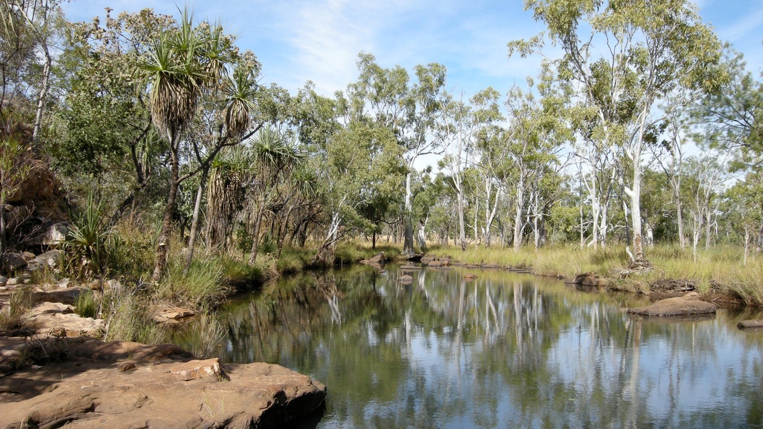
Plant Taxonomy BIOLOGY 353

Slide 2
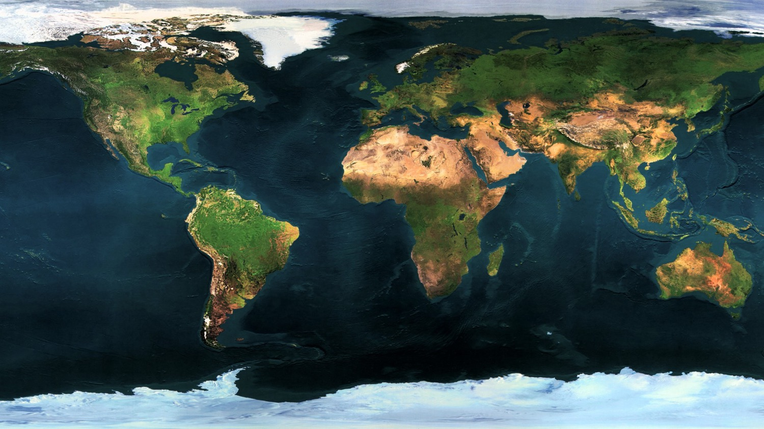

Slide 3
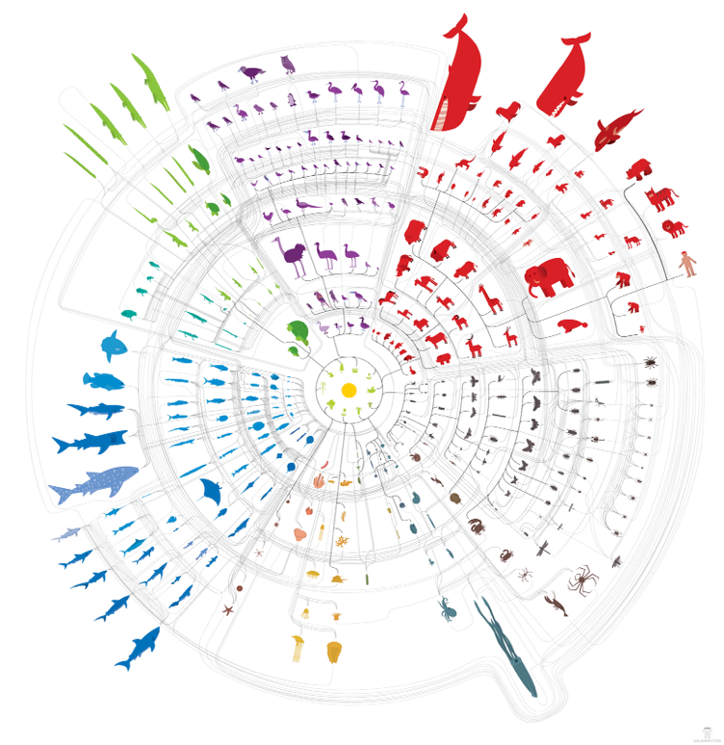

Slide 4
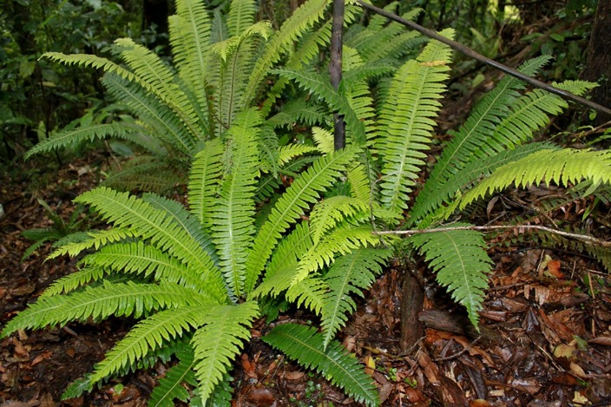
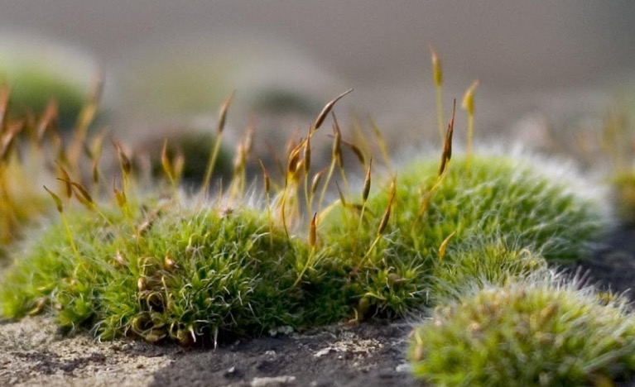
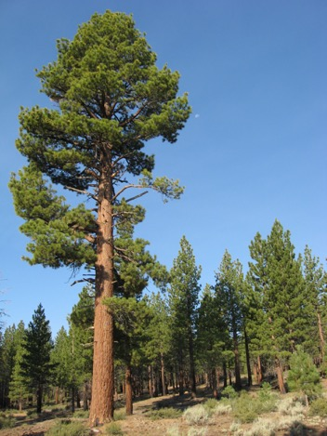
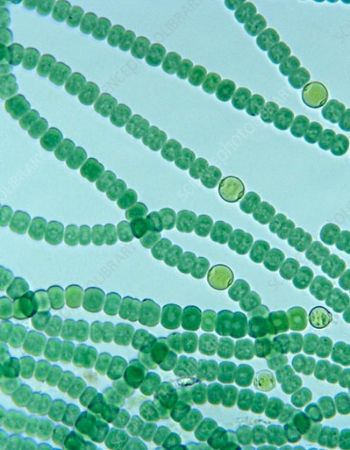
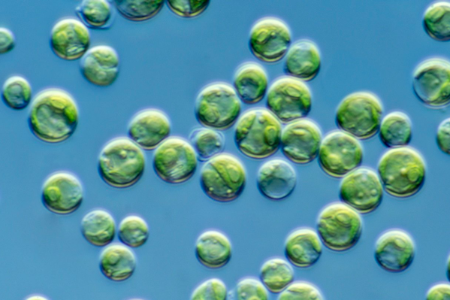
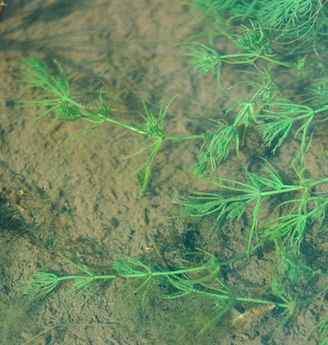
What exactly is a plant?

Slide 5
Plant diversity
Plants (i.e., land plants): ~ 450,000 species
Multicellular, generally photosynthetic with chloroplasts
Moss
Conifer
Fern

Slide 6
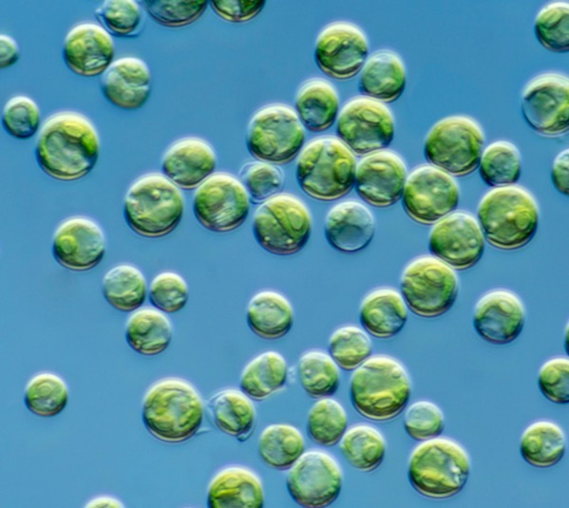
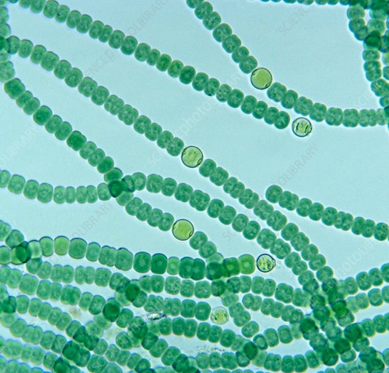
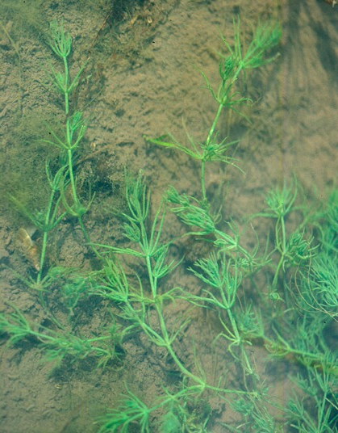
Plant diversity
Other photosynthetic organisms include cyanobacteria (prokaryotes) and algae and phytoplankton (mostly one- or few-celled eukaryotes)
Chlorella (green algae)
Anabaena (cyanobacteria)
Chara (green algae)

Slide 7
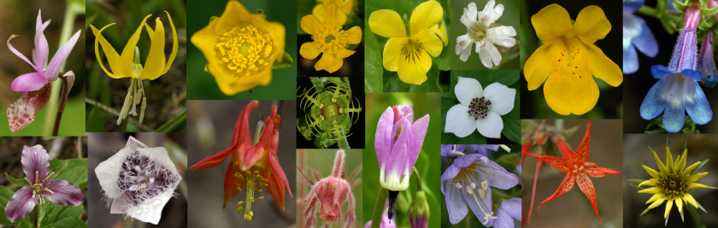
Angiosperm diversity
Angiosperms (i.e., flowering plants): ~ 350,000 species

Slide 8

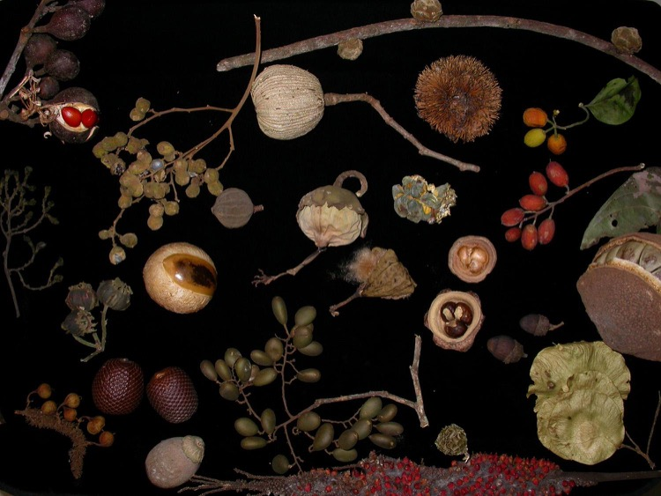
Angiosperm diversity
Flowering and fruiting plants

Slide 9
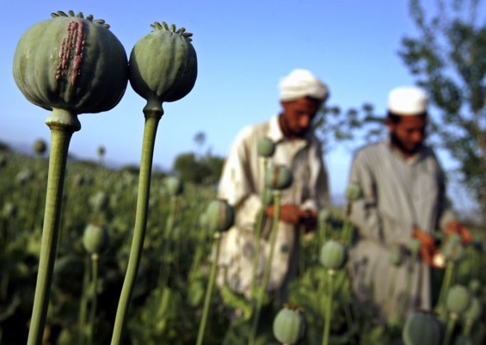
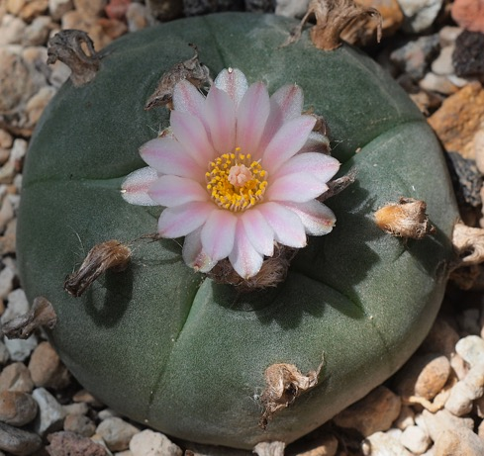
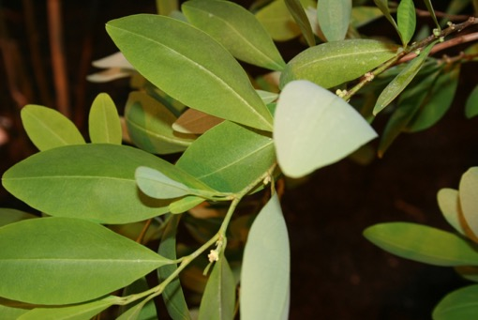
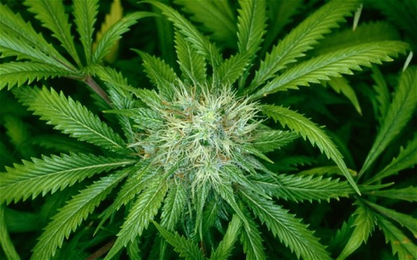
Opium poppy
Papaver somniferum
Papaveraceae
Peyote
Lophophora williamsii
Cactaceae
Coca
Erythroxylum coca
Erythroxylaceae
Marijuana
Cannabis sativa
Cannabaceae

Slide 10
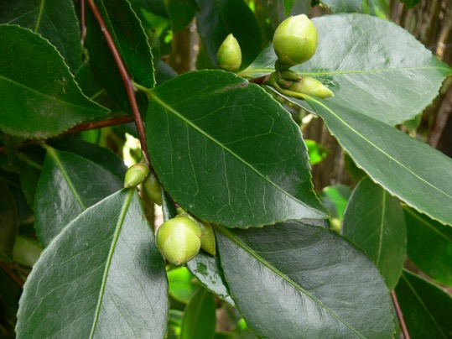
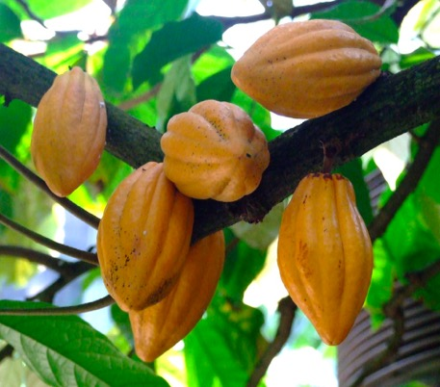
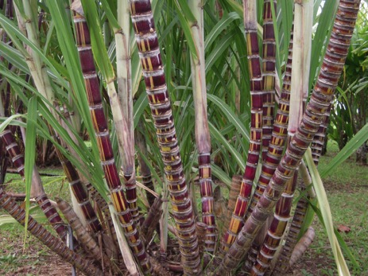
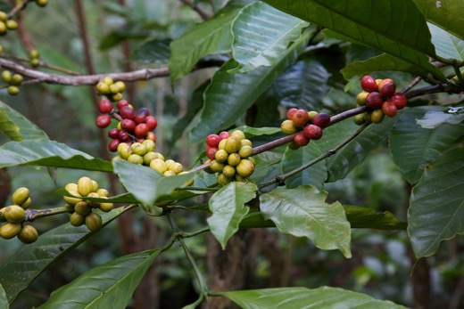
Tea
Camellia
Theaceae
Cacao
Theobroma cacao
Malvaceae
Sugarcane
Saccharum officinarum
Poaceae
Coffee
Coffea arabica
Rubiaceae

Slide 11
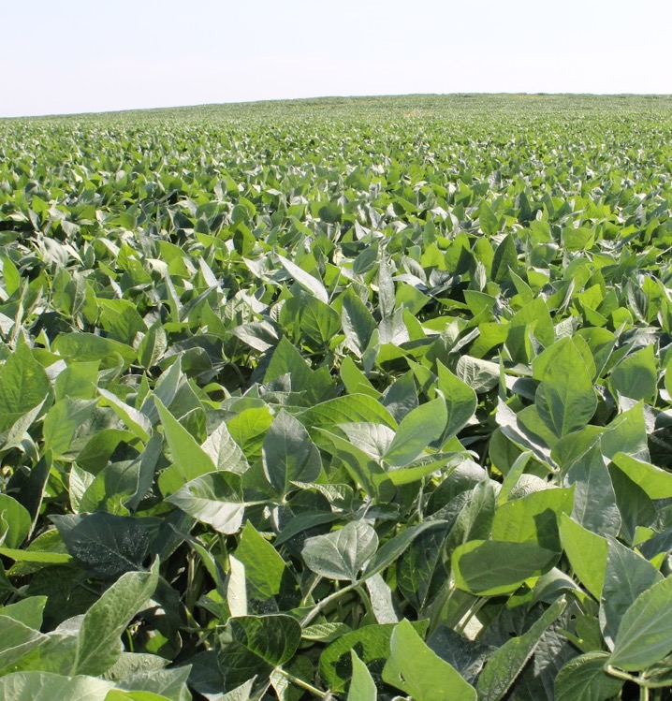
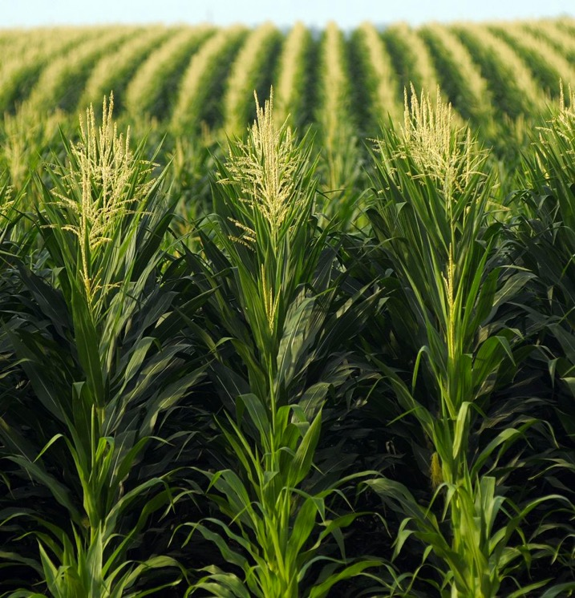
Glycine max
Fabaceae
Zea mays
Poaceae

Slide 12
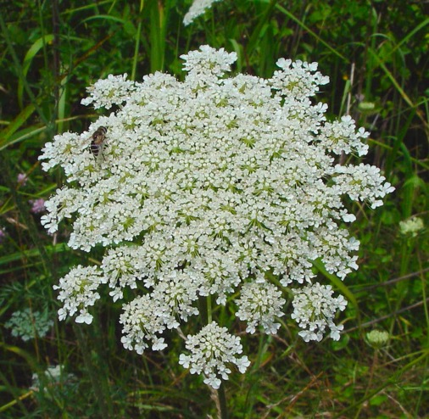
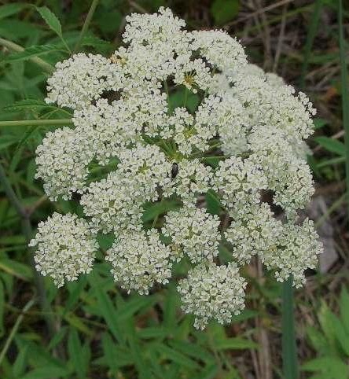
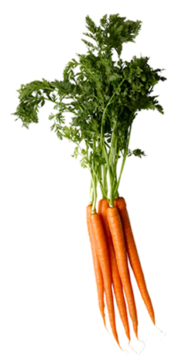

The importance of correct identification
Carrot
Daucus carota
Apiaceae
Hemlock
Cicuta maculata
Apiaceae

Slide 13

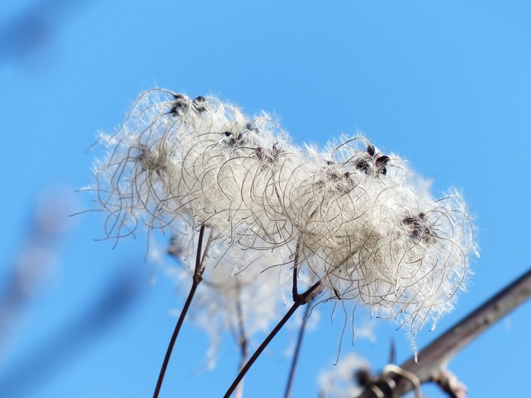
Not everyone is a good botanist
Cotton plants are in the genus Gossypium (family Malvaceae)
…but this image shows Clematis vitalba (family Ranunculaceae)

Slide 14
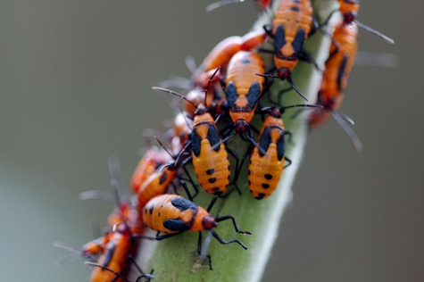
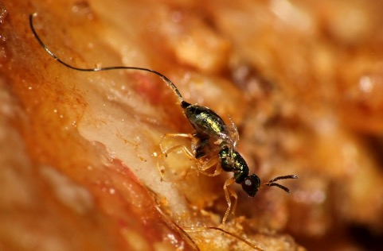
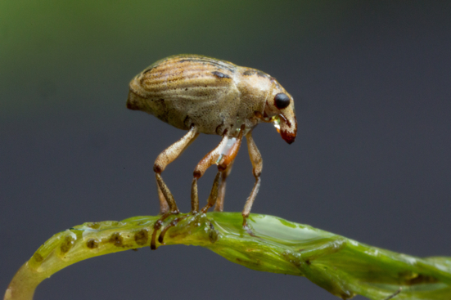
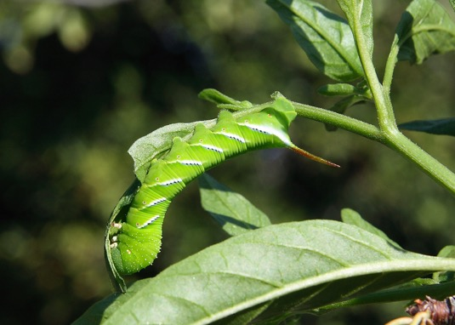
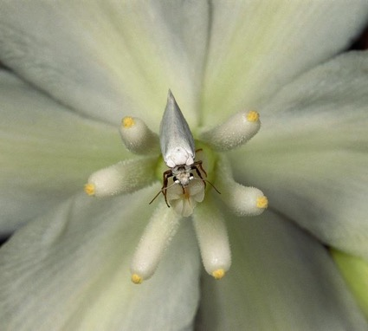
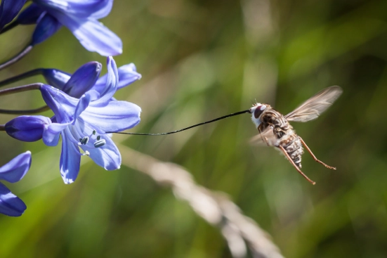
Animal taxonomists
Milkweed bugs
Milfoil weevil
Fig wasp
Tomato hornworm caterpillar
Yucca moth
Long-tongued fly

Slide 15
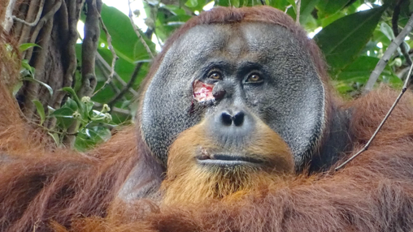

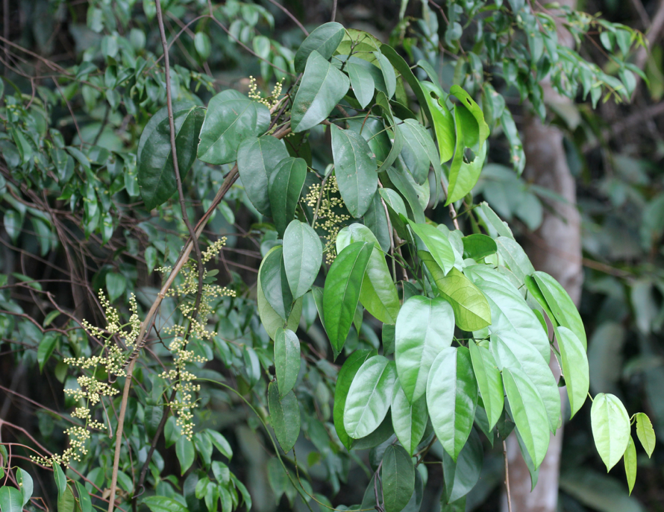
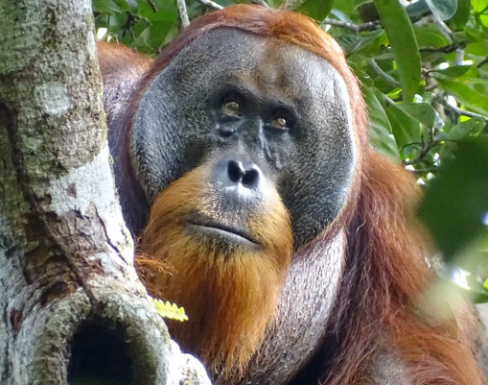
Fibraurea tinctoria
Menispermaceae
https://doi.org/10.1038/s41598-024-58988-7
https://www.npr.org/2024/05/03/1248879197/orangutan-wound-medicinal-plant-treatment

Slide 16

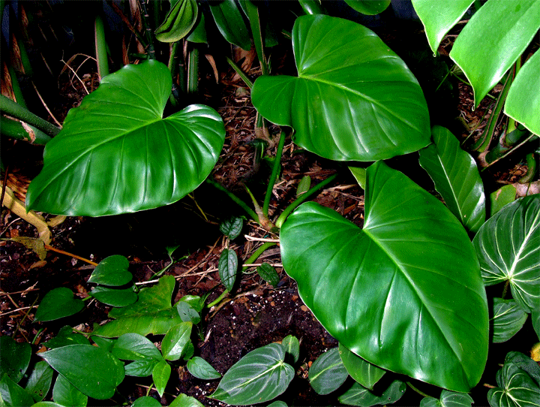
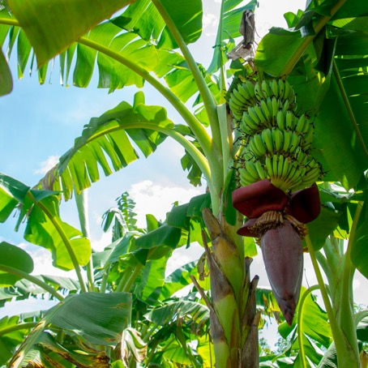
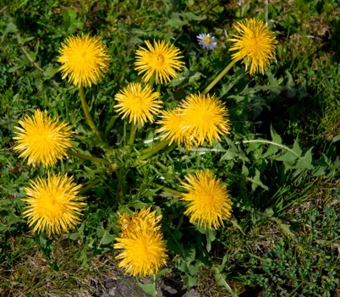
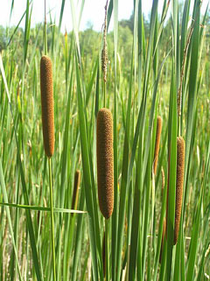
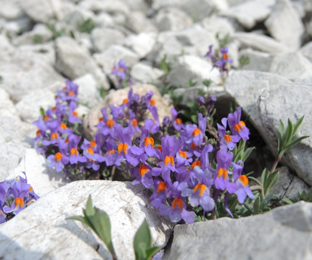
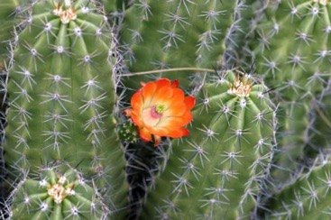
Plant ecology
Coconut palm
Cocos nucifera
Arecaceae
Philodendron
Araceae
Dandelion
Taraxacum
Asteraceae
Banana
Musa
Musaceae
Linaria alpina
Plantaginaceae
Cattail
Typha
Typhaceae
Cactus
Cactaceae

Slide 17
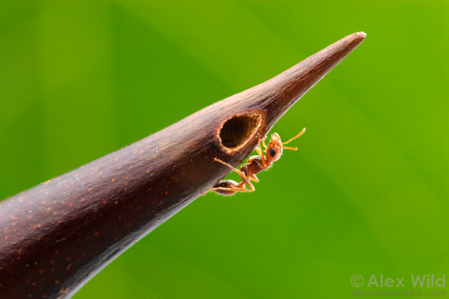
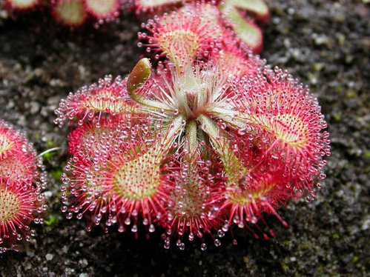
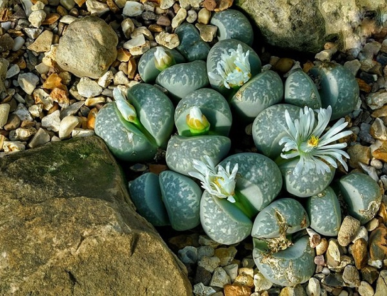
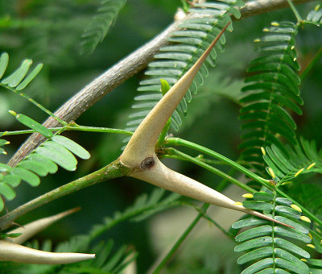
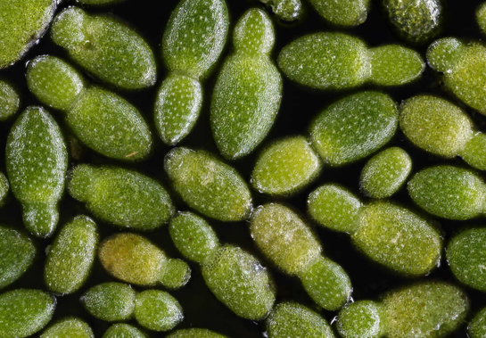
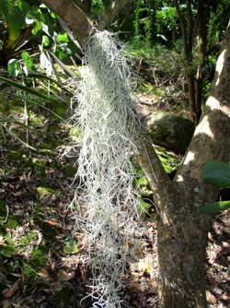
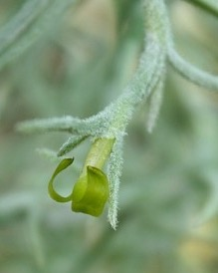
Plants are cool!
Acacia
Fabaceae
Sundew
Drosera
Droseraceae
Lithops
Aizoaceae
Wolffia
Lemnaceae
‘Spanish moss’
Tillandsia
Bromeliaceae

Slide 18


Course objectives
General plant morphology – vegetative and reproductive
Phylogenetic relationships among species
System of classifying plant species
Survey of plant diversity
Methods to identify plant species

Slide 19

Wisconsin plant diversity
Families
99 dicot
32 monocot
3 gymnosperm
16 ferns and relatives
Genera
586 dicot
172 monocot
8 gymnosperm
33 ferns and relatives
240 non-vascular
We’ll cover these mostly

Slide 20
What you’ll learn
At least a passing mention of all terrestrial seed plant families in Wisconsin
Terrestrial: not aquatic (see BIOLOGY 359 - Aquatic Plant Biology)
Seed plants: not ferns, mosses, etc., but some mention of these
About 50 families to know by name (common or scientific)
Tools for identifying plant families, genera, species
Practice identifying

Slide 21

Too many to learn/memorize!
About 50 family names you should know
Families with > 30 species
Around 4 per class, 20 per exam

Slide 22


New this year
Traditional format: family names, morphology terms, memorization
Organized by taxonomy
Our approach: connections, practice, modern tools
Organized by features

Slide 23

‘Plant Taxonomy’
Ongoing effort to describe and categorize life on earth
Evolutionary context: how did things get to be the way they are?
Useful features for describing and identifying plants
https://doi.org/10.1038/s41586-024-07324-0

Slide 24
Taxonomy: classification
Eukaryotes
Plants (land plants)
Flowering plants
Monocots / Eudicots / other

Slide 25

Nomenclature: rules for names
Common hepatica:
Anemone hepatica or Hepatica acutiloba?

Slide 26


Phylogenetics: depicting evolution with trees
Whittall and Hodges, 2007
Columbine

Slide 27

Phylogenetic overview
Land plants originated from green algal ancestor
Successive evolution of
Vascular tissue (water-conducting)
Seeds
Flowers / fruits
https://doi.org/10.1038/s41586-019-1693-2

Slide 28







Systematics - considering all evidence at once
https://doi.org/10.3767/blumea.2021.66.03.08
Magnolia

Slide 29

The textbooks
Electronic textbook – access through VitalSource link on Canvas

Slide 30


The textbooks
Physical books – bring these for field trips and certain labs

